Slide 1
Fitness Data Trends
Presented By: Riffat Adnan, Shannon Allotey, Hunter Davis and Emilia Elangwe

Slide 2
A View of
Fitness Trends
Over a period of 4 months our user collected data for the following categories:
        Date
        Step Count
        Mood(Boolean)
        Calories Burned
        Hours of Sleep
        Active Day(Boolean)
        Weight

Slide 3
We Set Out to Answer a Few Questions…
1) Does an Active Day Increase or Decrease Sleep?
2) Does an Active Day Improve Mood?
3) Does an Active Day Result in an Increased Number of Calories Burned?
4) Does Consistency in Activity Result in Longer Stretches of Positive Moods?

Slide 4
Does an Active Day Increase or Decrease Sleep?

Slide 5
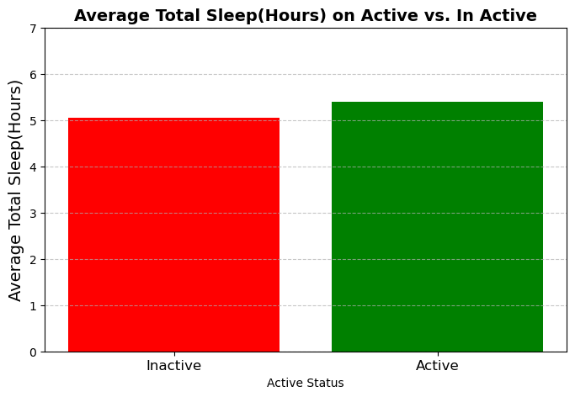

Slide 6
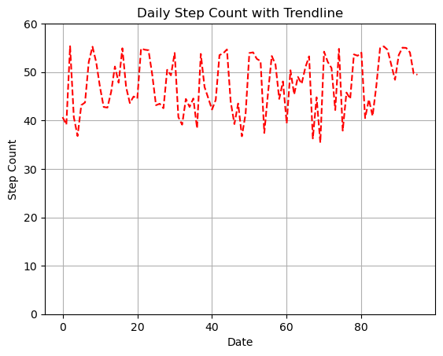
SA

Slide 7
Does an Active Day Improve Mood?

Slide 8
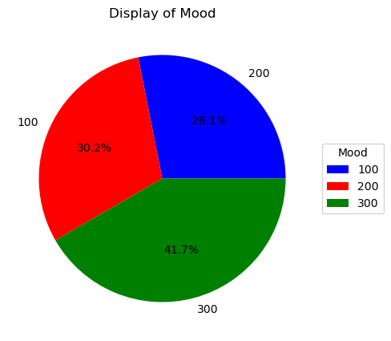

Slide 9
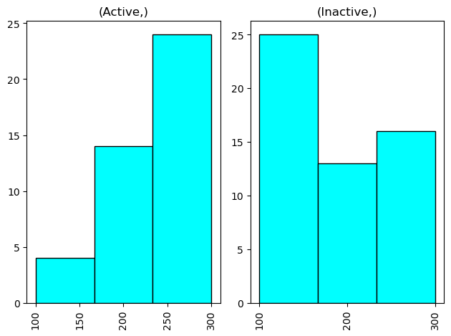
HD

Slide 10
Does an active day result in an increased number of calories burned?

Slide 11
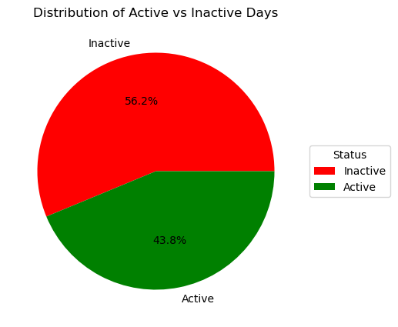

Slide 12
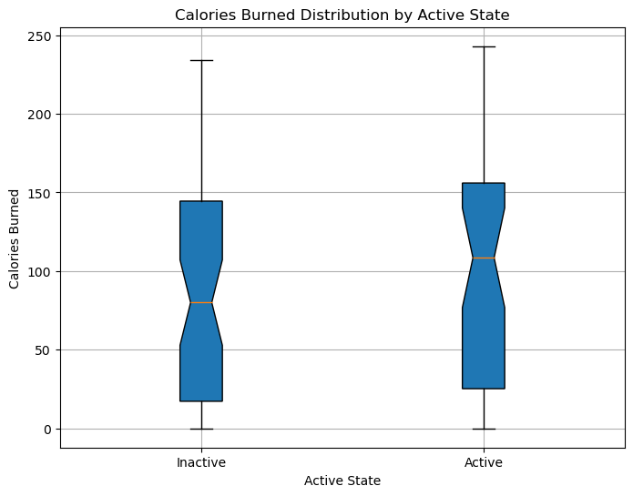
EE

Slide 13
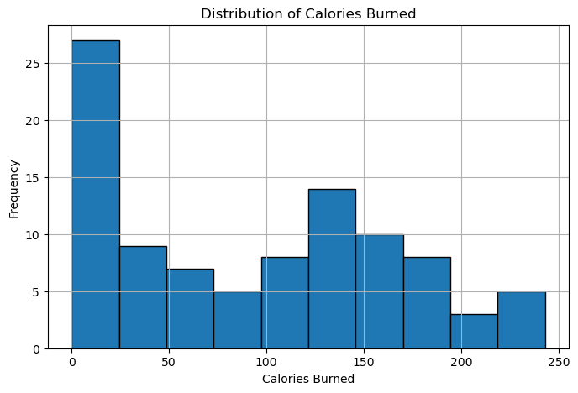

Slide 14
Does Consistency in Activity Result in Longer Stretches of Positive Moods?

Slide 15
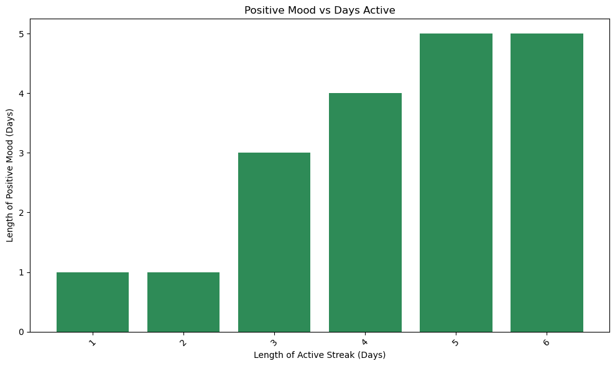
RA

Slide 16
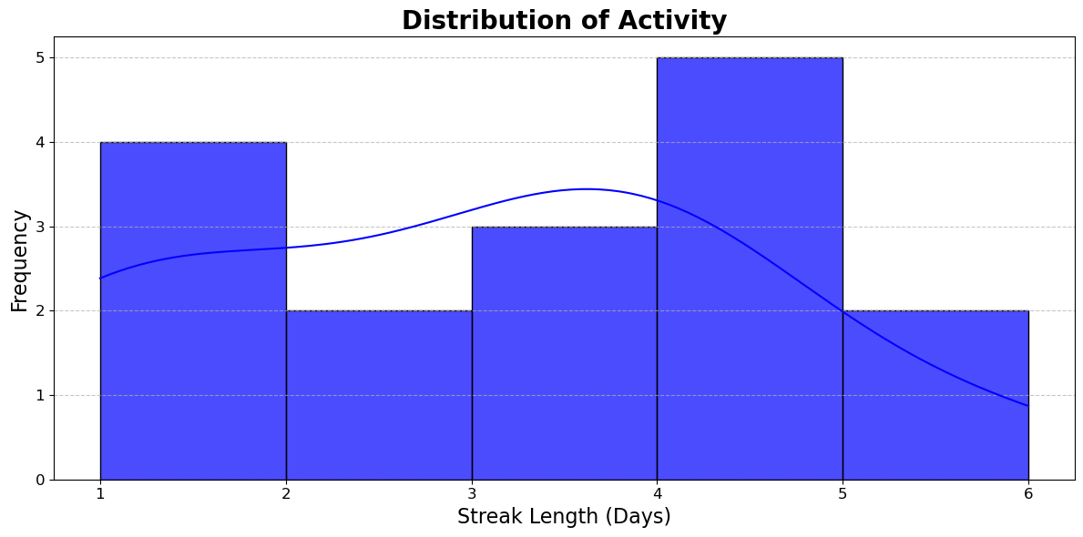
RA

Slide 17
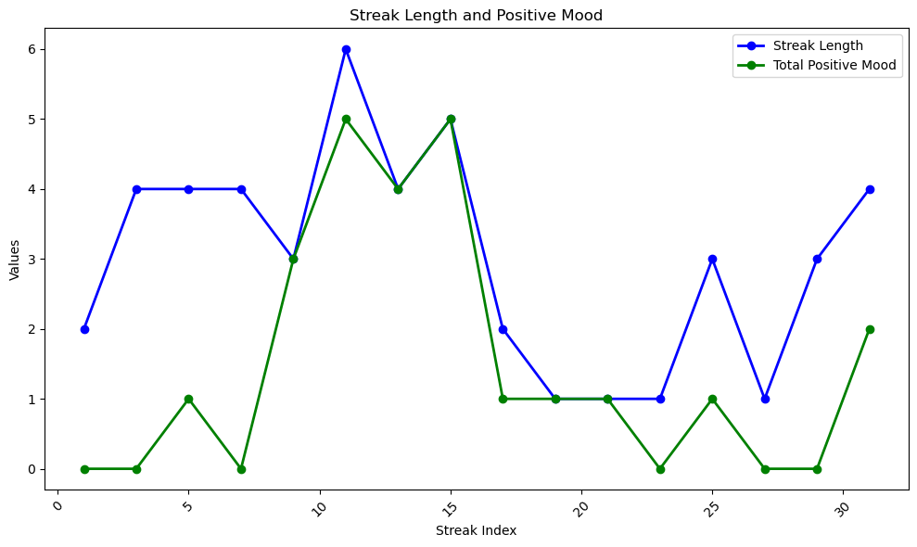

Slide 18
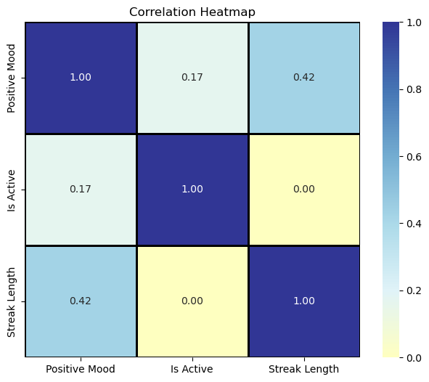

Slide 19
Closing Thoughts
While a moderate correlation exists between Overall Well-being and Level of Activity, the study found no significant association between Sleep, Activity, Calories Burned relative to the Mood State. These results underscore the necessity for further investigation into the factors that influence activity Levels, Sleep, Calories Burned, and Mood, indicating potential areas for targeted interventions to enhance Overall Well-being.

Slide 20
Thank You For Your Time!

